Slide 1






Model compression on large language models
By Abhinav Anand

Slide 2
TABLE OF CONTENTS
Introduction
motivation
challenges
Dataset overview
Methodology and models
Model compression technique
Experiment and evaluation method
Result and analysis
Conclusion
references
01
02
03
04
05
06
07
08
09

Slide 3

INTRODUCTION
Large Language Models (LLMs) have revolutionized NLP
Achieve high performance in tasks like generation, understanding, and translation
Challenges with high computational cost and resource constraints

Slide 4


Motivation
Need for scalable and efficient LLMs
Importance in information retrieval, content generation, cross-lingual communication
Environmental impact due to high computational requirements

Slide 5

challenges
01
02
03
04
Preserving semantic richness
Balancing size reduction with performance retention
Task-specific adaptation
Managing computational overheads during compression

Slide 6







PROBLEM STATEMENT
OBJECTIVE 01
OBJECTIVE 02
OBJECTIVE 03
Goal: Explore and assess model compression methods for LLMs
Focus on summarization and translation tasks
Importance of optimizing efficiency and performance balance

Slide 7






Dataset overview
CNN/Daily Mail
Used for text summarization
286,817 training pairs
Format: news stories with summary bullets
WMT 14 English-German:
Used for translation tasks
445,7749 training pairs
Sources: Europarl, News Commentary, TED Talks

Slide 8


METHODOLOGY AND MODELS
Models Used:
BART: Denoising autoencoder for translation
T5: Text-to-text transformer for summarization
Compression Techniques:
Pruning
Quantization
Knowledge Distillation

Slide 9
MODELS COMPRESSION TECHNIQUE
PRUNING
QUANTIZATION
Knowledge Distillation
Removes unnecessary parameters
Simplifies the model
Reduces parameter precision
Lowers memory usage
Speeds up inference
Trains smaller model (student) to mimic larger model (teacher)
Transfers knowledge efficiently

Slide 10
EXP.AND EVALUATION METHODS
We conducted experiments using the T5 model for summarization and the BART model for translation
Evaluation metrics:
ROUGE for summarization
BLEU for translation

Slide 11



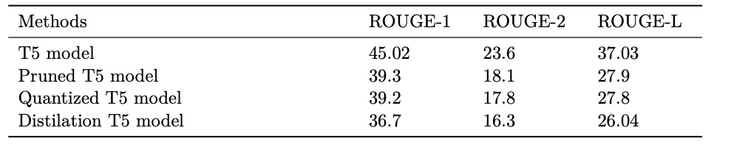

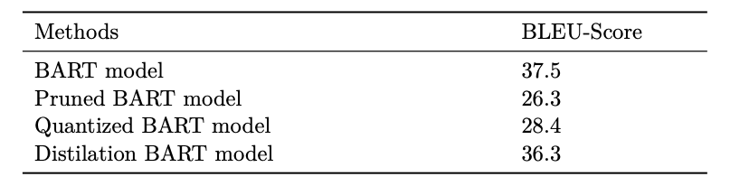
RESULTS AND ANALYSIS
Summarization (T5): Performance of T5 models on all compression techniques.
01
Translation (BART): Performance of BART models on all compression techniques.
02

Slide 12


conclusion
Compression reduces performance but offers size and speed benefits
Distillation and pruning provides the best balance between size reduction and performance

Slide 13
REFERENCES
[1] Hugh A Chipman, Edward I George, and Robert E McCulloch. Bart: Bayesian additive regression trees. The Annals of Applied Statistics, 4(1):266–298, 2010.
[2] Colin Raffel, Noam Shazeer, Adam Roberts, Katherine Lee, Sharan Narang, Michael Matena, Yanqi Zhou, Wei Li, and Peter J Liu. Exploring the limits of transfer learning with a unified text-to-text transformer. Journal of machine learning research, 21(140):1– 67, 2020.
[3] Xunyu Zhu, Jian Li, Yong Liu, Can Ma, and Weiping Wang. A survey on model compression for large language models. arXiv preprint arXiv:2308.07633, 2023

Slide 14

THANK YOU!

